Slide 1
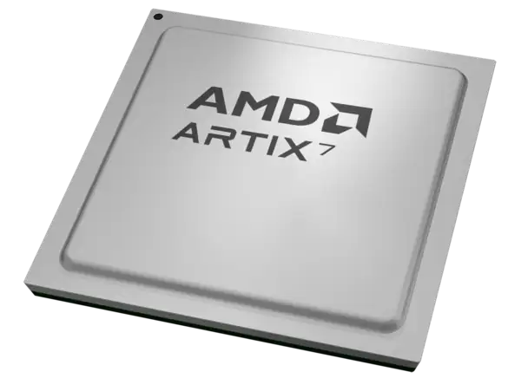
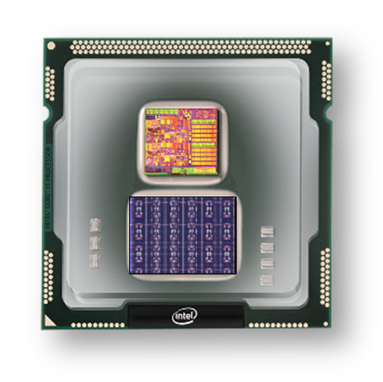
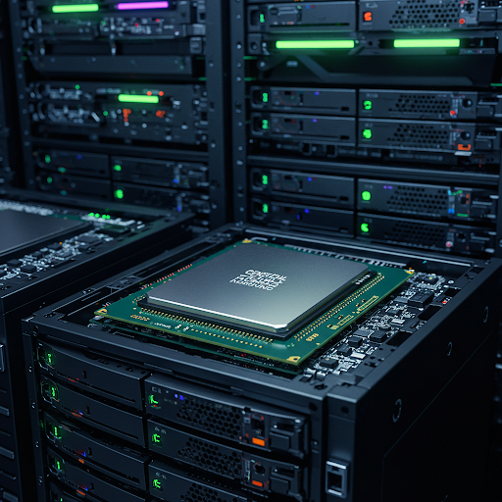
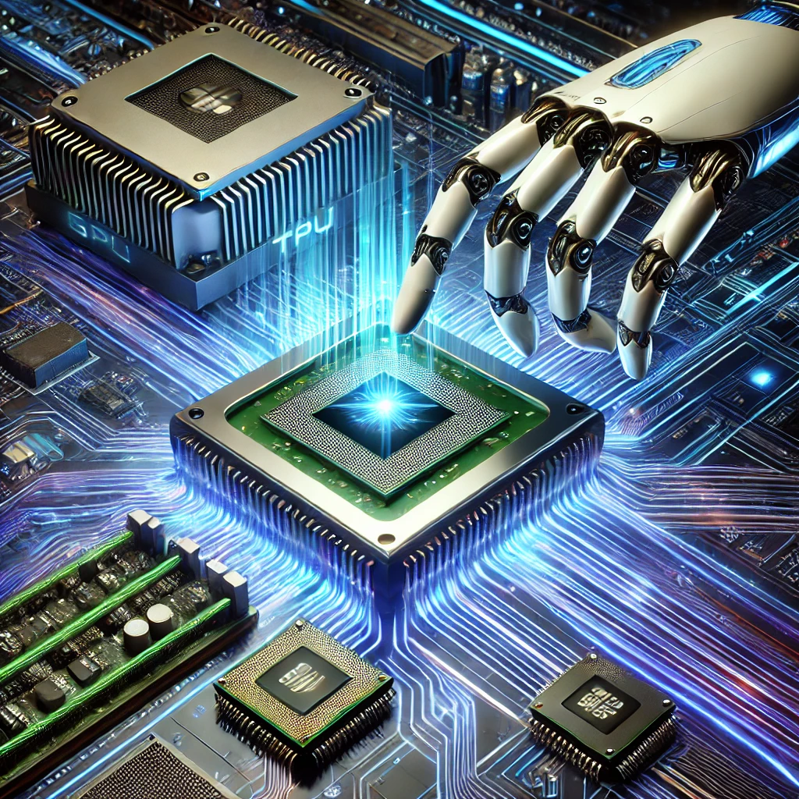
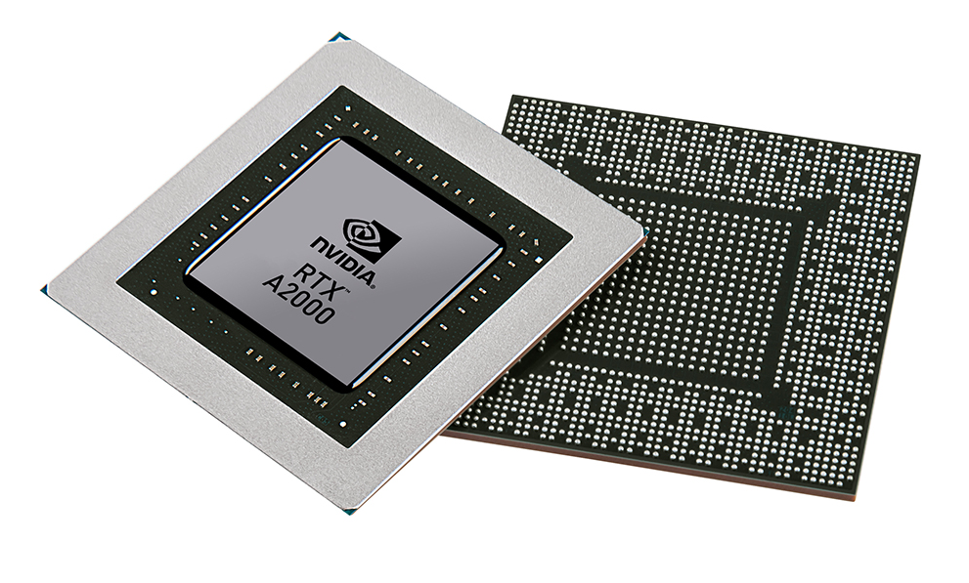


Christof Teuscher
ECE 410/510: Hardware for AI and ML
Codefest #6: Practice HW/SW co-design with design iterations
Portland State University
Department of Electrical and Computer Engineering (ECE)
www.teuscher-lab.com
teuscher@pdx.edu

Slide 2
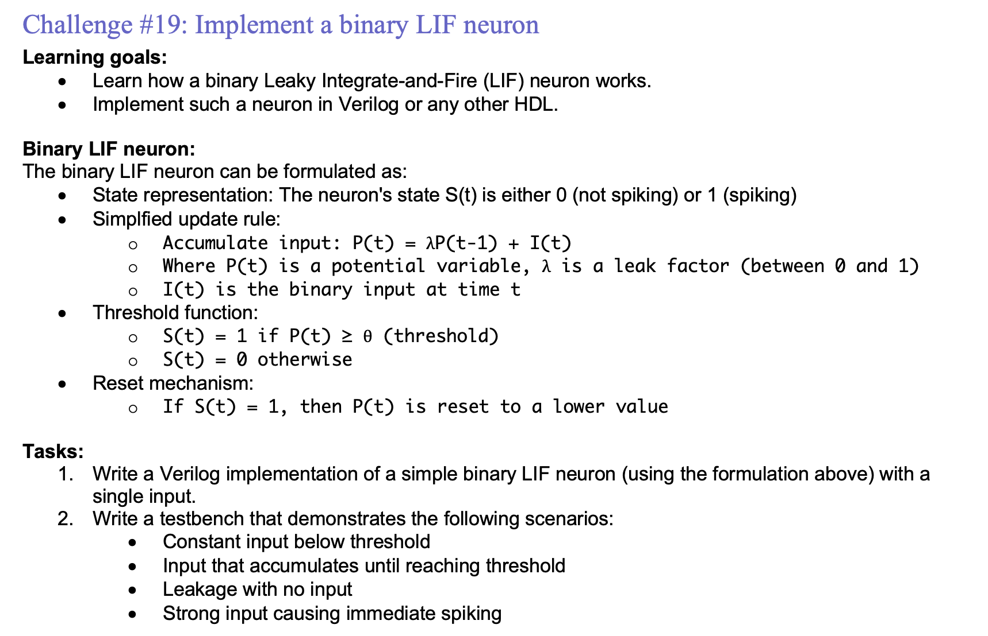
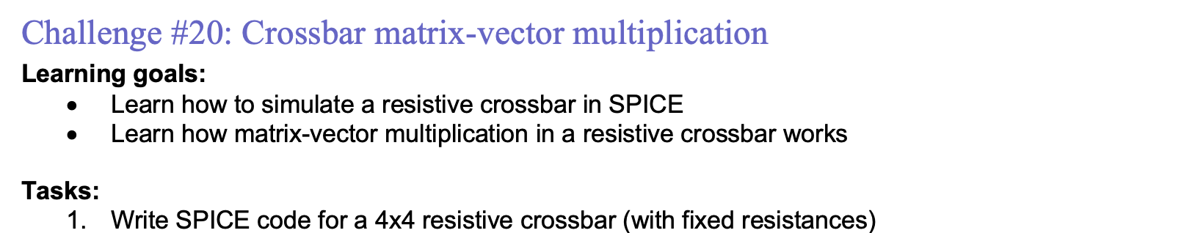
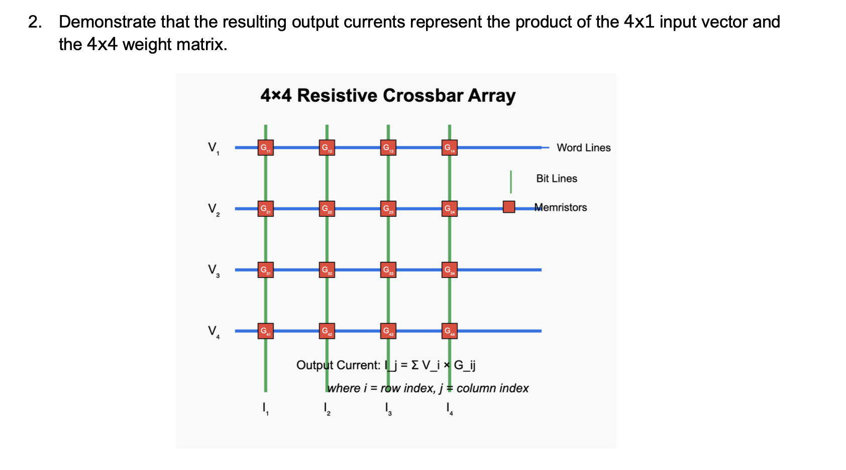
Weekly challenges

Slide 3
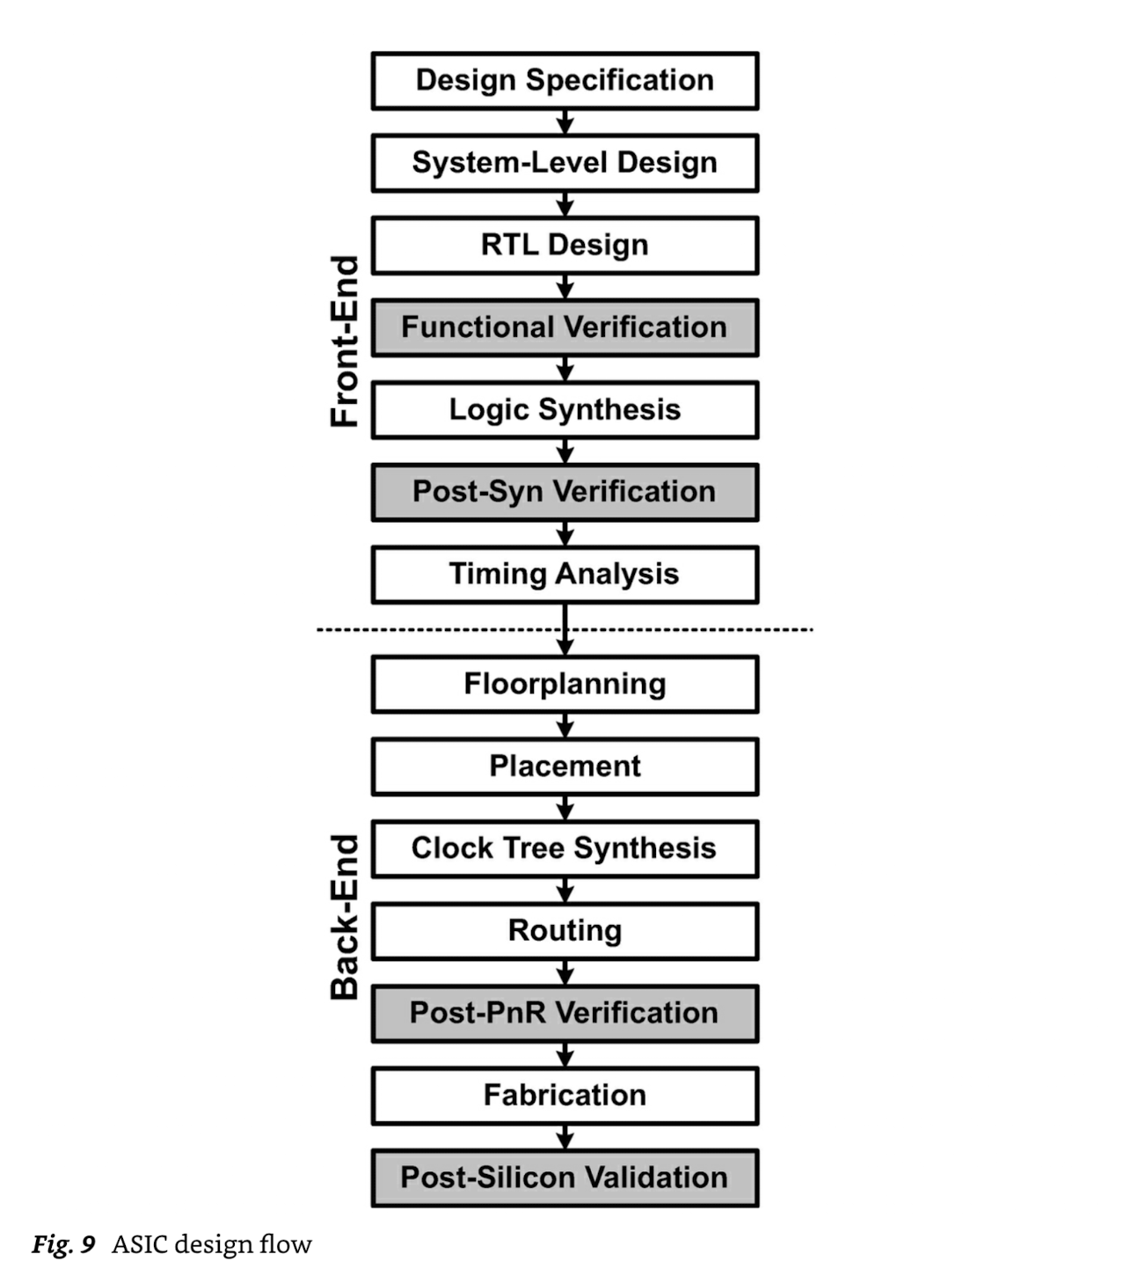
ASIC design flow
Python
Verilog/SystemVerilog/VHDL
logic and architecture designs
physical design
Max. frequency, # transistors, etc.
Mishra, Ashutosh; Cha, Jaekwang; Park, Hyunbin; Kim, Shiho. Artificial Intelligence and Hardware Accelerators.

Slide 4
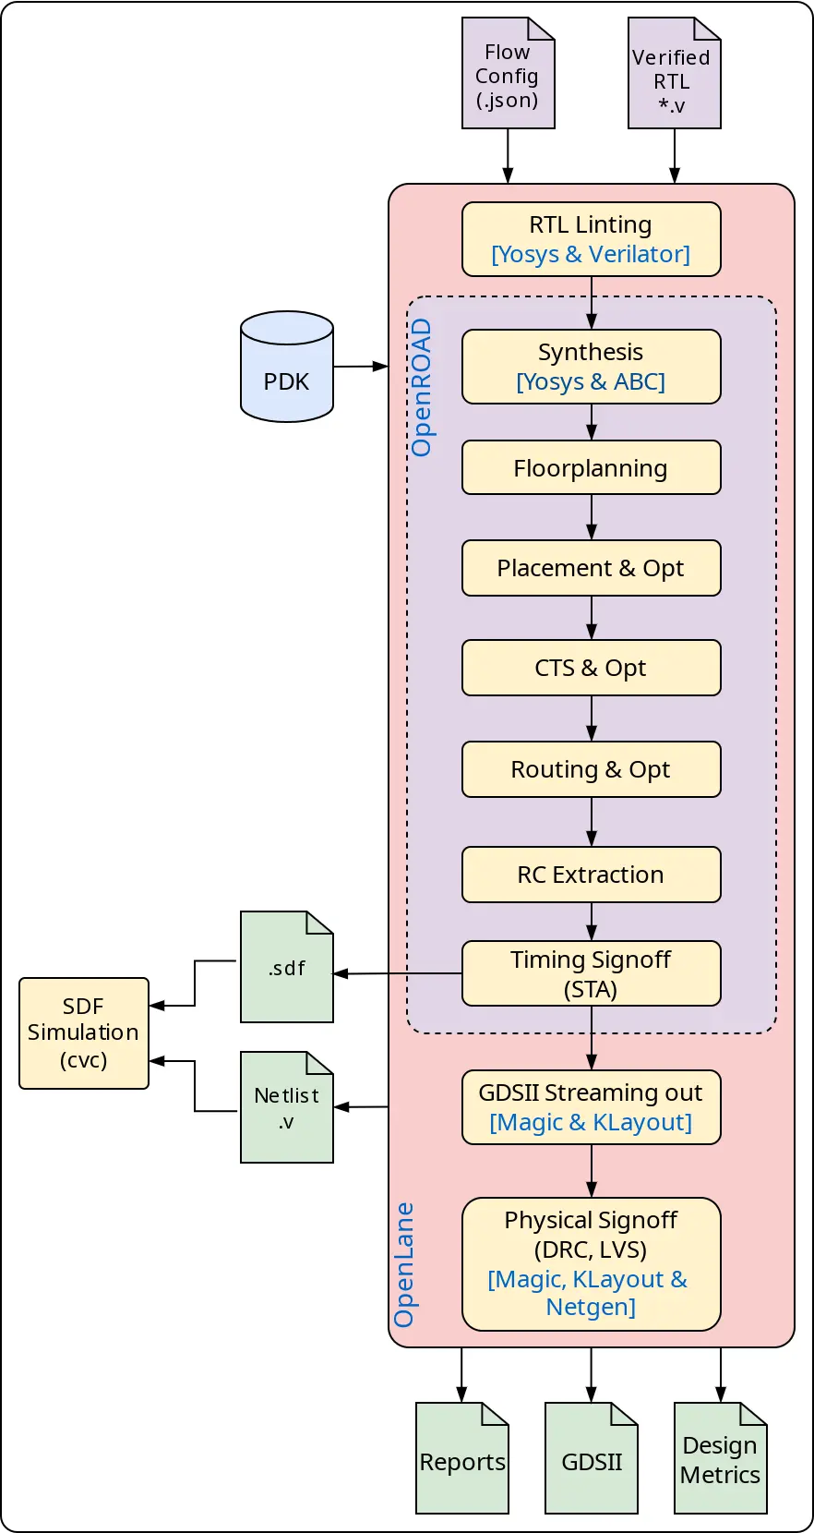
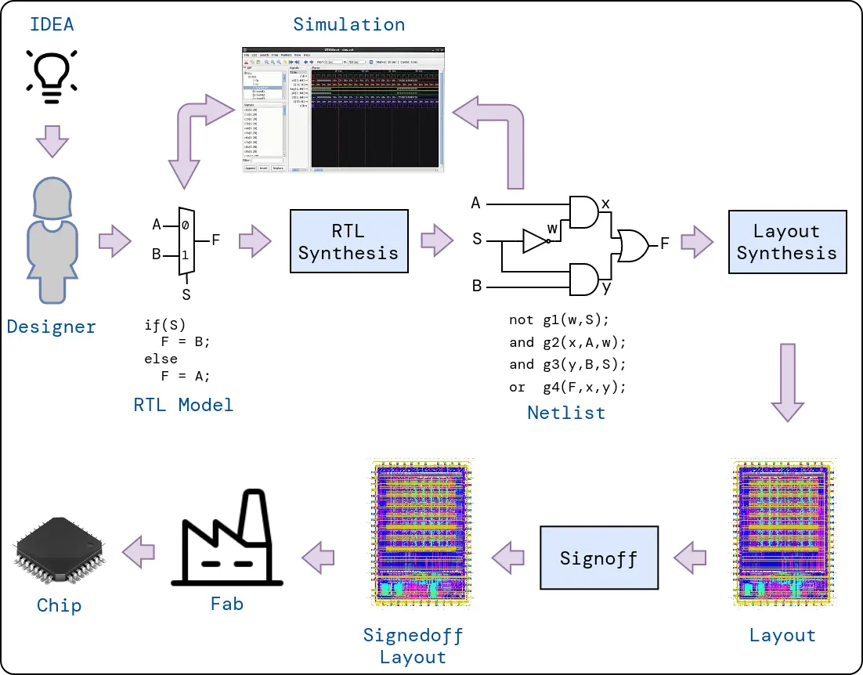
OpenLane 2 tools
https://efabless.com/openlane
https://github.com/efabless/openlane2
https://openlane2.readthedocs.io/en/latest/getting_started/newcomers/index.html

Slide 5
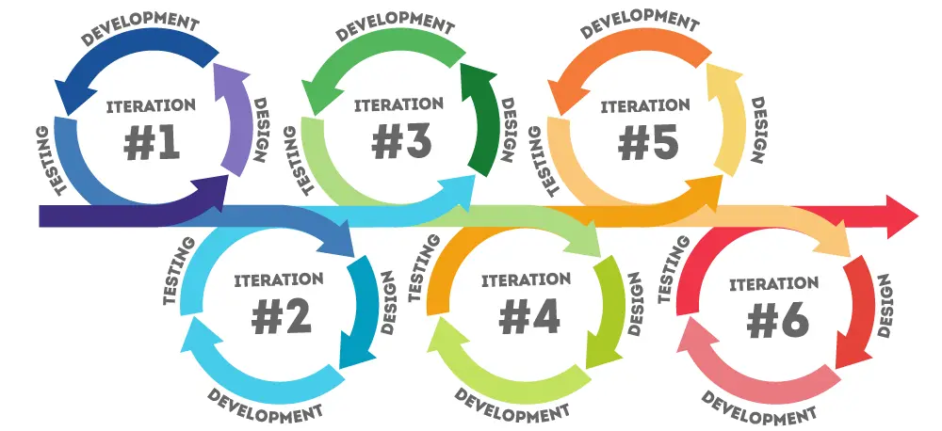
Main goals for today
Based on your initial results, go back to the drawing board and do a design iteration.
https://www.pacific-research.com/iterative-product-development

Slide 6

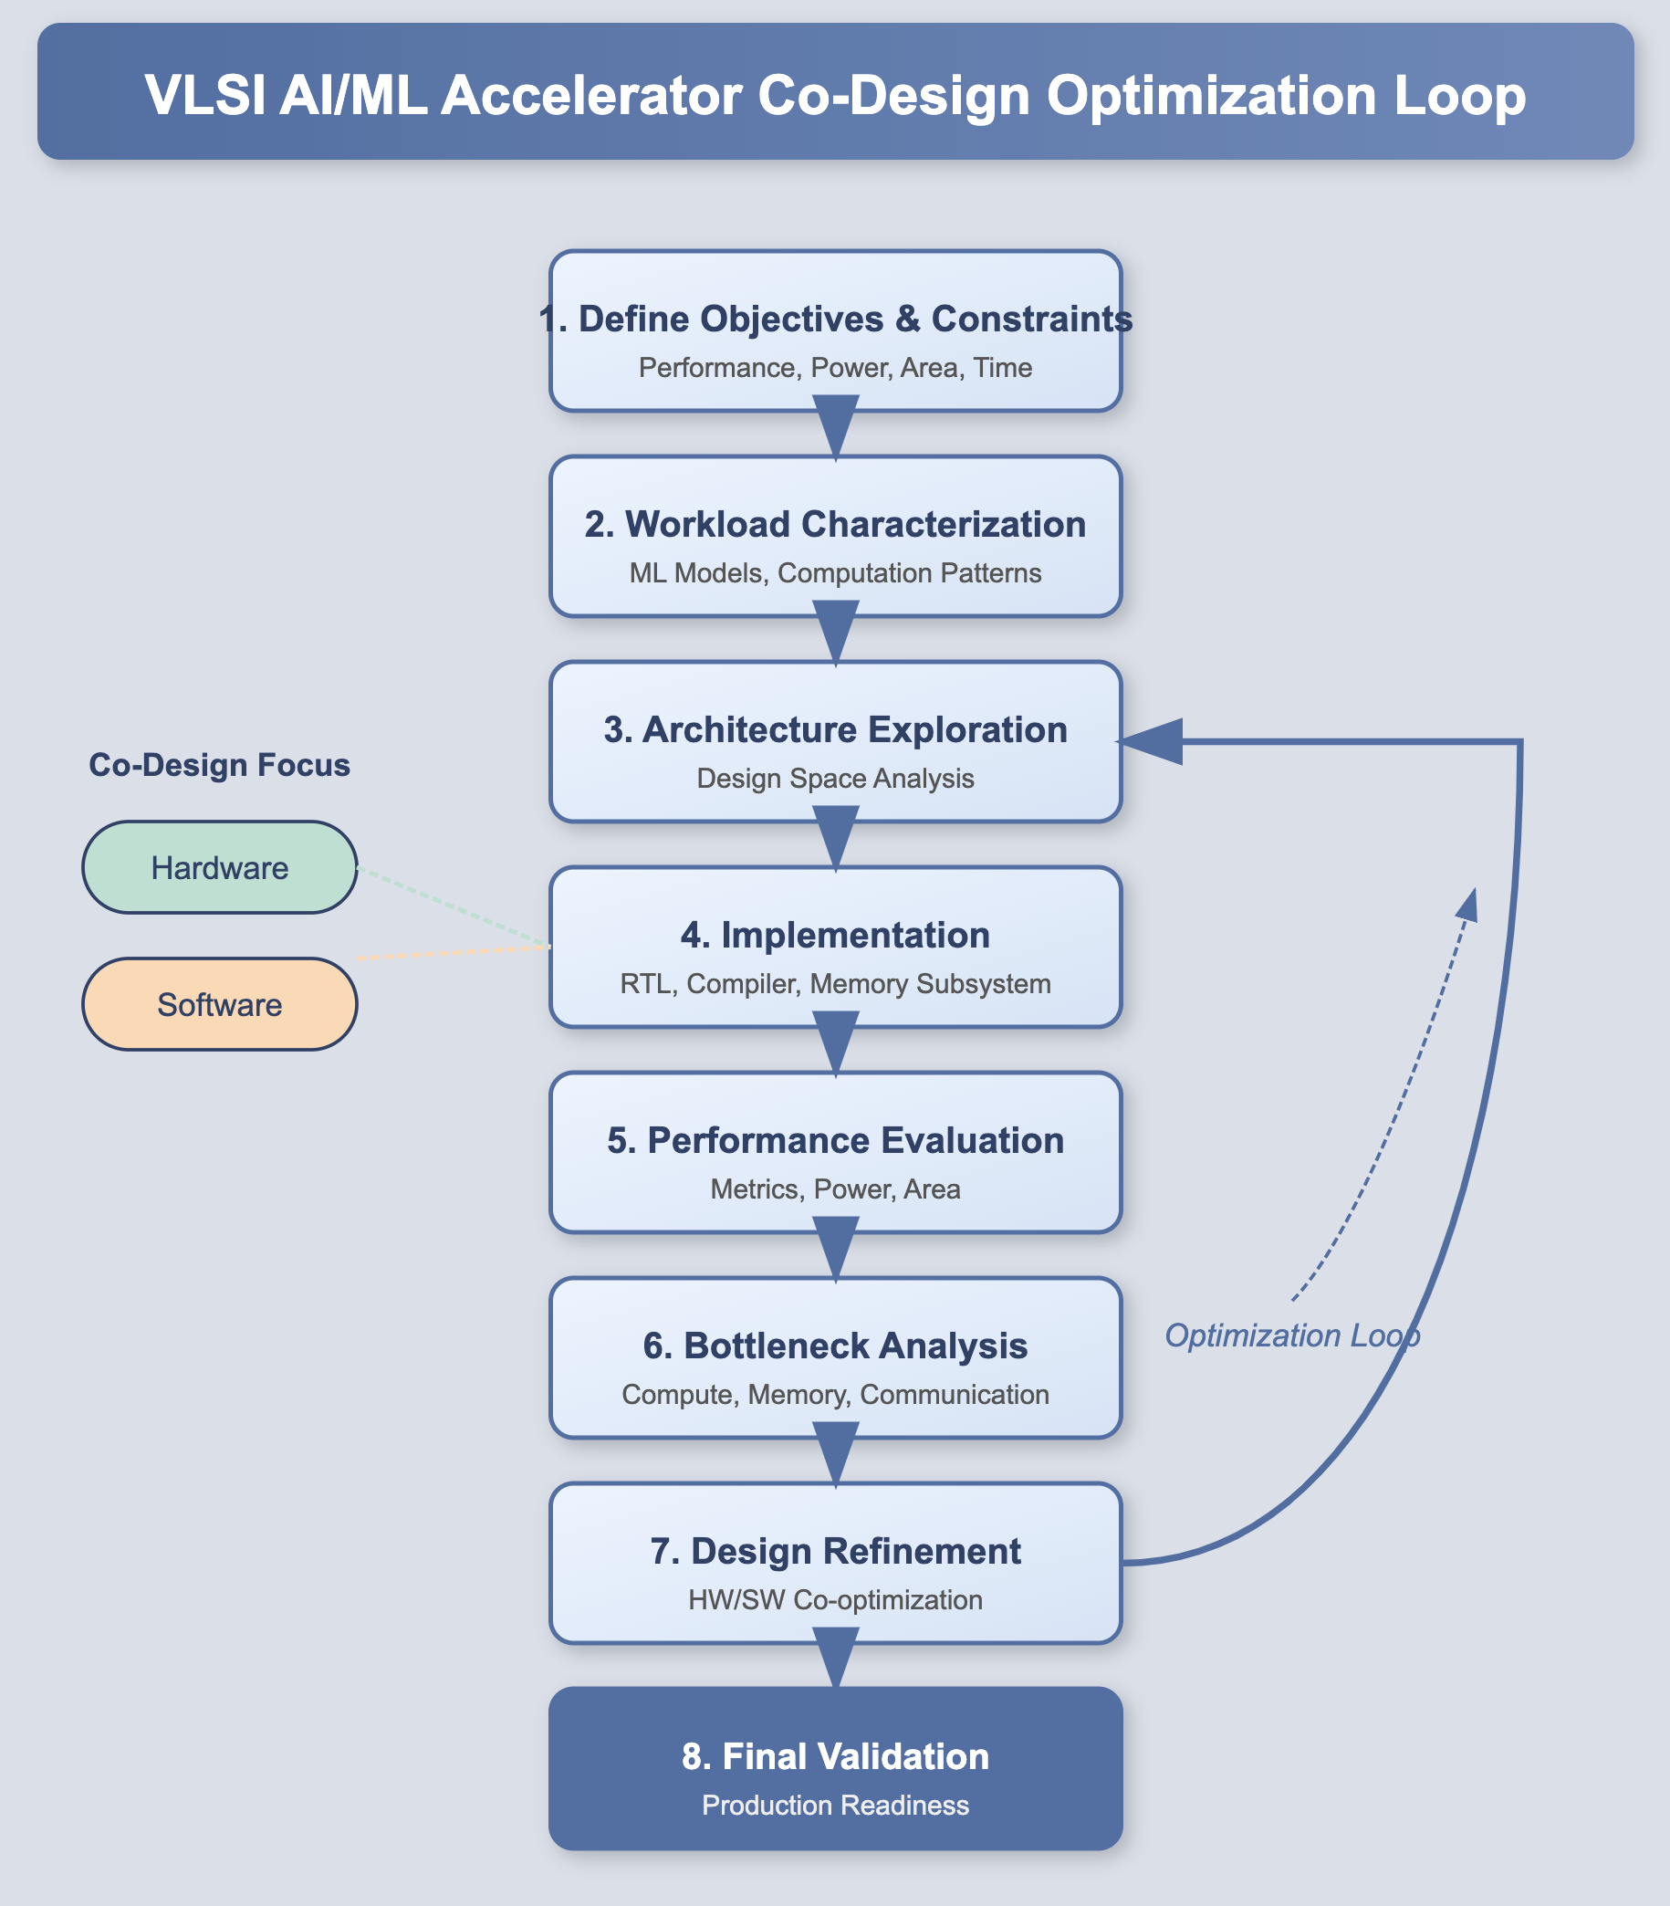

Slide 7
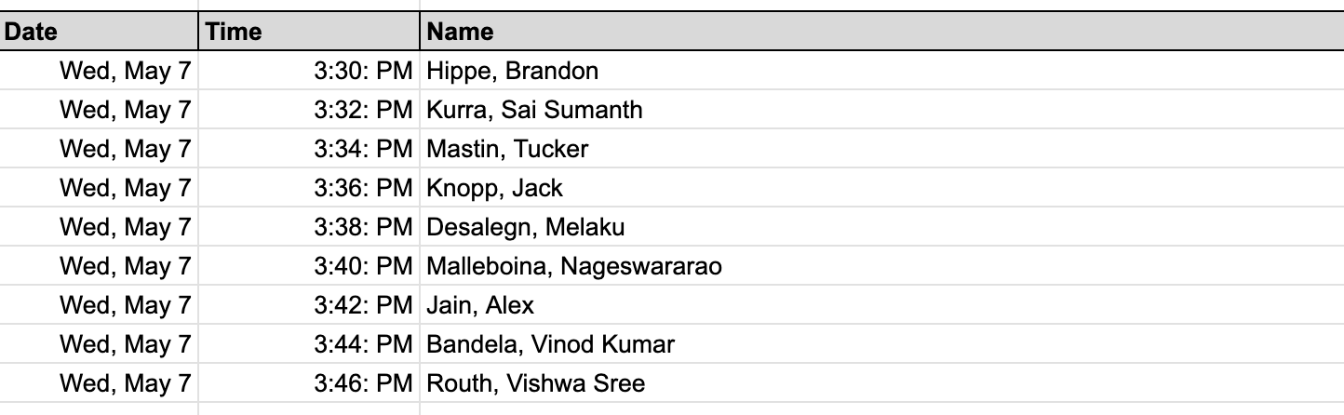
Today’s presentations

